Slide 1
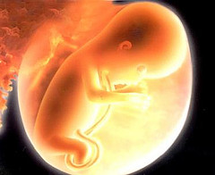
LA REPRODUCTION

Slide 2
Reproduction is the biological mechanism by which the human species is perpetuated.
Reproduction in humans:
Is sexual: there are two sexes with different morphological and physiological characteristics (sexual dimorphism).
Viviparous development: the first phases of the development are carried out inside specialized organs of the mother.
Reproductive functions are regulated by hormones.
Development of a new life begins when a male and a female gamete (sex cells), unite and form a cygote in a process called called fertilization .

Slide 3
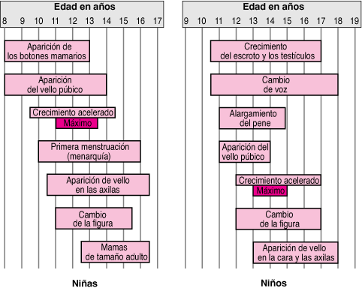
The reproductive system is responsible for producing sex cells or gametes.
This process begins during puberty along with the appearance of secondary sex characteristics.

Slide 4
FEMALE REPRODUCTIVE SYSTEM
It is formed by:
Internal genitalia
External genitalia
breasts

Slide 5
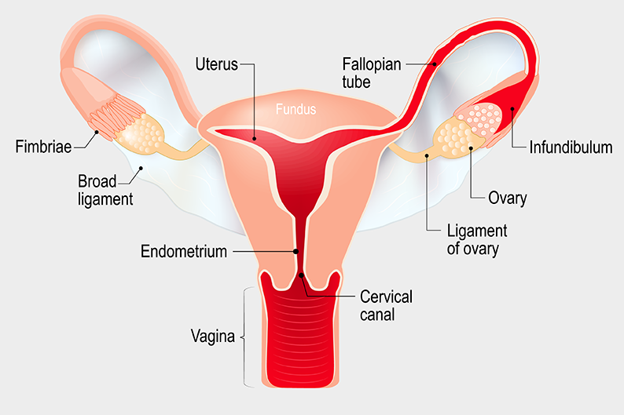
INTERNAL GENITALIA
Ovaries: organs found that produces ovules.
Fallopian tube: The uterine tube connects the ovary to the uterus. It’s where the ovule is fecundated.
The uterus is a hollow muscular organ located in the female pelvis between the bladder and rectum. Once the egg has been fertilized is implanted in the lining of the uterus. The main function of the uterus is to nourish the developing foetus prior to birth.
Vagina: The muscular canal that extends from the cervix to the outside of the body. Its walls are lined with mucous membrane.

Slide 6
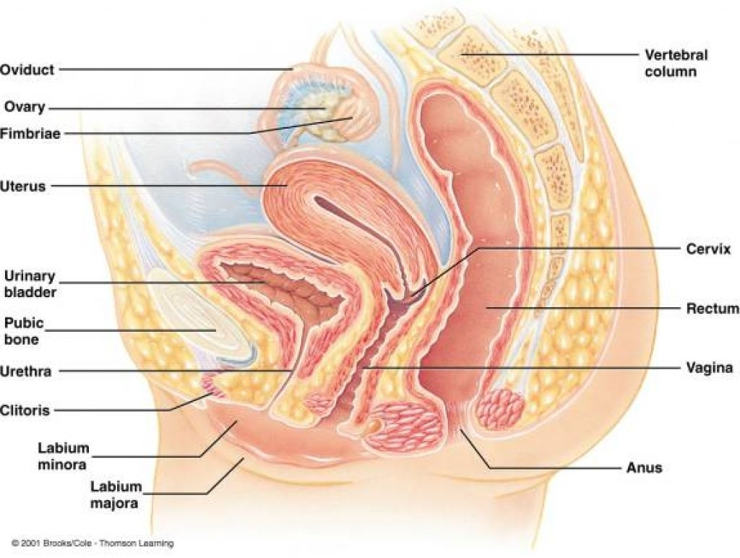
INTERNAL GENITALIA

Slide 7
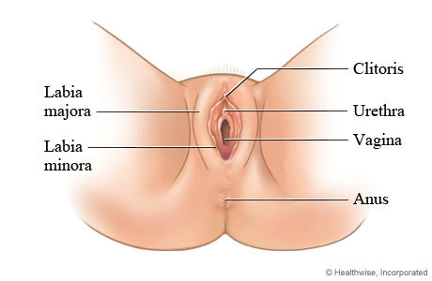
EXTERNAL GENITALIA
Labia Majora | Two prominent longitudinal cutaneous folds that together with the labia minora form the labia of the vulva.
Labia Minora | Two folds of skin that form the lateral boundaries of the vulval or pudendal cleft, which receives the openings of the vagina and the urethra.
Clítoris | A small mass of erectile tissue in the female that is situated at the anterior apex of the vulva, near the meeting of the labia majora (vulvar lips). The clitoris corresponds to the penis in the male.
Hymen | is thin piece of mucosal tissue that surrounds or partially covers the external vaginal opening.

Slide 8
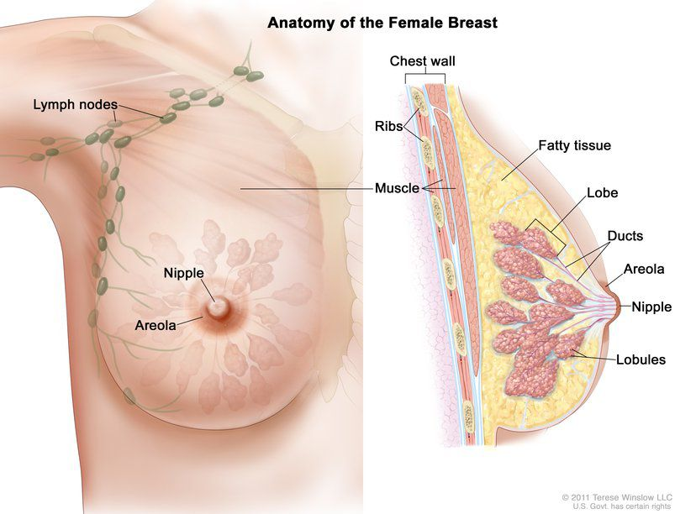
BREAST
The breast refers to the front of the chest or, more specifically, to the mammary gland.
The mammary gland is a milk producing gland.
Within the mammary gland is a complex network of branching ducts.
These ducts exit from sac-like structures called lobules, which can produce milk in females.
The ducts exit the breast at the nipple.

Slide 9
MALE REPRODUCTIVE SYSTEM
External genitalia
Pene | A male erectile organ of copulation by which urine and semen are discharged from the body and that develops from the same embryonic mass of tissue as the clitoris
Scrotum | A thin external sac of skin that is divided into two compartments; each compartment contains one of the two testes

Slide 10
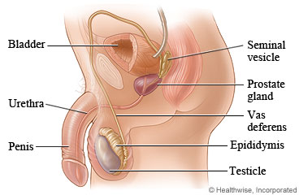
Internal genitalia
Testes: two oval-shaped male reproductive glands that produce sperm and the hormone testosterone.
Epididymis: a highly convoluted duct behind the testis, where the sperm matures and along which sperm passes to the vas deferens
Vas or ductus deferens: are the tubes that connects the testes with the urethra.
Seminal vesicles: Each of a pair of glands which open into the vas deferens near to its junction with the urethra and secrete many of the components of semen.
Postate gland: organ that surrounds at the base of the bladder, which controls the release of urine and secretes an alkaline fluid that makes up part of the semen and enhances the motility and fertility of sperm.
Uretra: The tube that travels through the penis and carries semen as well as urine

Slide 11
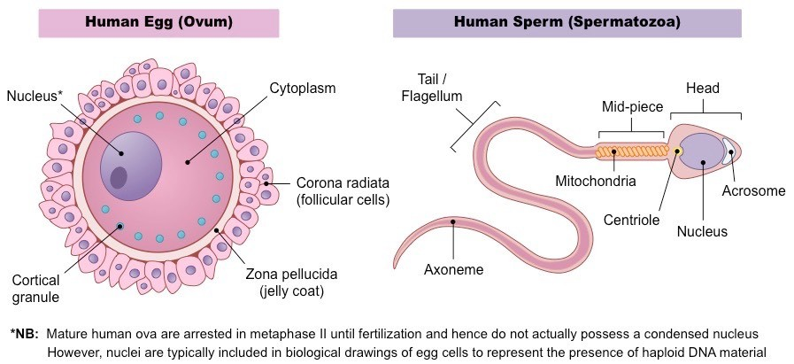

Slide 12
Ovogenesis
Espermatogenesis
Process of development and maturation of females gametes
Process of development and maturation of sperm cells
It begins during the development of the foetus
It stops from birth to puberty. Then, it resumes and continues throughout the fertile life.
At birth, in the ovaries of a girl there are around 400,000 future eggs, of which only ripen about 400 or 450 since puberty, this period is called menarche.
By age 50, ovules stop ripening. This stage is called menopause.
The male gamete formation begins at puberty and then lasts a lifetime. This is done in the testicles.

Slide 13
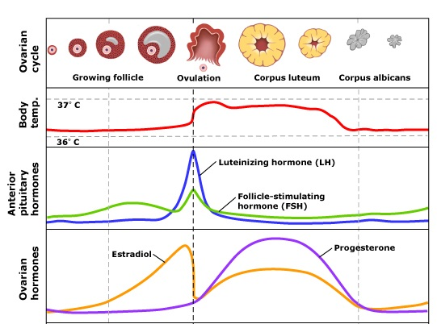
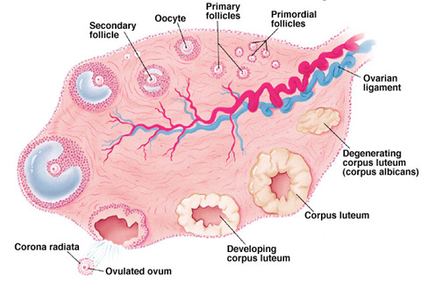
OVARIAN CYCLE AND MENSTRUAL CYCLE
The ovarian cycle governs the preparation of endocrine tissues and release of eggs.
The menstrual cycle governs the preparation and maintenance of the uterine lining. These cycles occur concurrently and are coordinated over a 22–32 day cycle, with an average length of 28 days.

Slide 14
Fase lútea
Si el óvulo no se encuentra con el espermatozoide en la Trompa de Falopio muere (puede durar de 1 a 3 días después de salir del ovario). Esto es lo que ocurre en la mayoría de los casos, bien porque no ha habido copulación o porque el espermatozoide no se ha encontrado con el óvulo (se han utilizado determinados métodos anticonceptivos que veremos más adelante o por otras causas).
Aproximadamente 14 días después de la ovulación, los ovarios dejan de producir hormonas y esto constituye la señal para que la capa que recubre el útero, el endometrio, se desprenda y salga por la vagina al exterior, produciendo una hemorragia denominada menstruación. Puede durar entre 3 y 4 días, pero su duración es variable en cada ciclo y en cada mujer.
El ciclo vuelve a empezar.

Slide 15
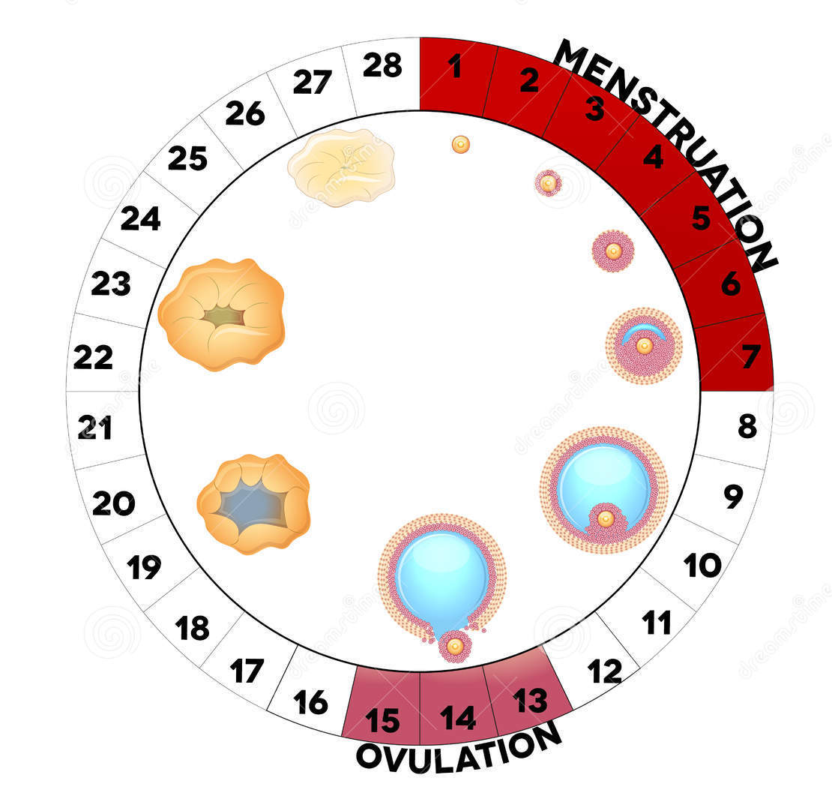
CICLO MENSTRUAL Y DESARROLLO FOLICULAR

Slide 16
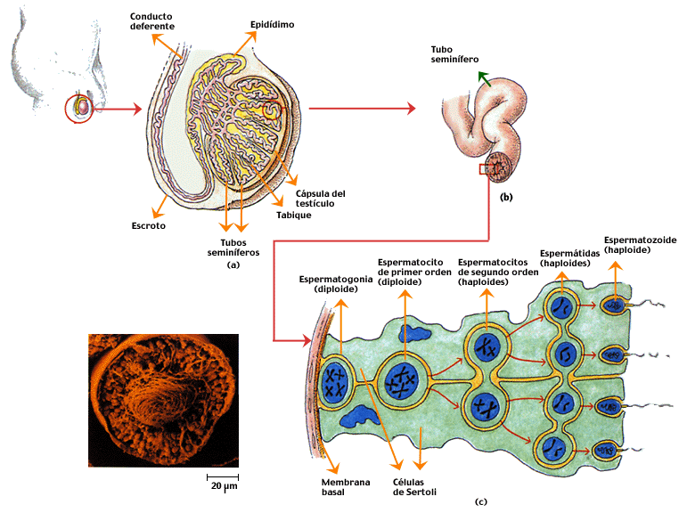

Slide 17
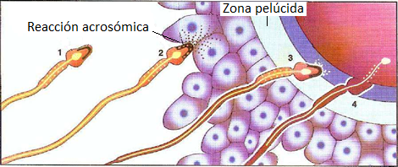
FECUNDACIÓN, EMBARAZO y PARTO
Fecundación
Proceso a través del cual se unen el óvulo y el espermatozoide.
En la especie humana la fecundación es interna, es decir se produce dentro del cuerpo de la mujer, concretamente en las Trompas de Falopio.
Para ello es necesario que se produzca la copulación o coito que consiste en la introducción del pene en la vagina y la posterior eyaculación del semen.

Slide 18
El semen pasará por la vagina, atravesará el útero y llegará a las Trompas de Falopio.
De los cientos de miles de espermatozoides, solamente unos pocos llegarán hasta el óvulo y solamente uno podrá atravesar la membrana plasmática del óvulo y producirse la fecundación.
Todos los demás espermatozoides son destruidos .
El óvulo fecundado es una nueva célula que vuelve a tener 46 cromosomas, ya que tendrá los 23 cromosomas del óvulo mas los 23 del espermatozoide y se denomina Cigoto.
El cigoto comenzará a desplazarse a través de las trompas hasta implantarse en el útero.

Slide 19
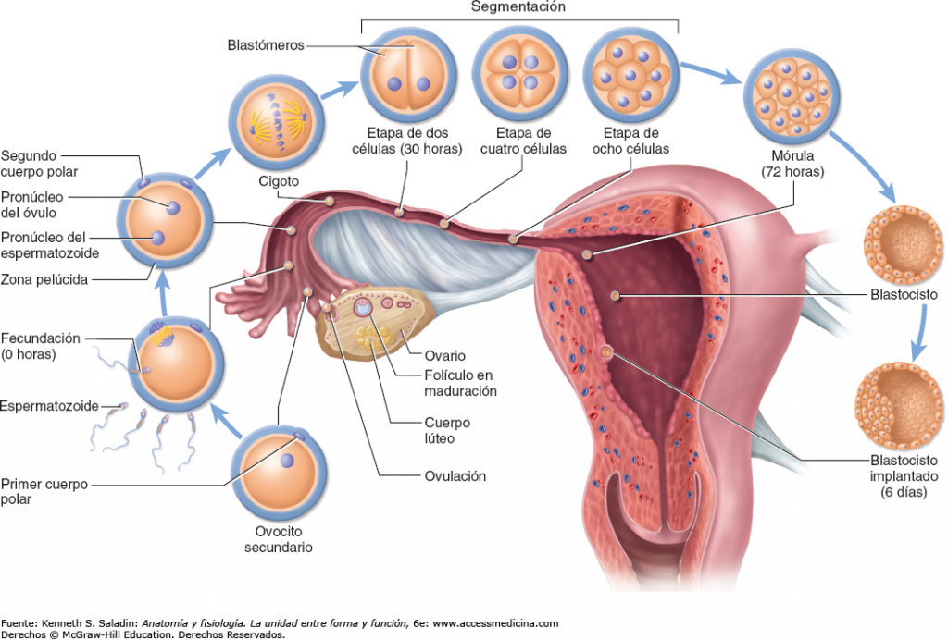

Slide 21
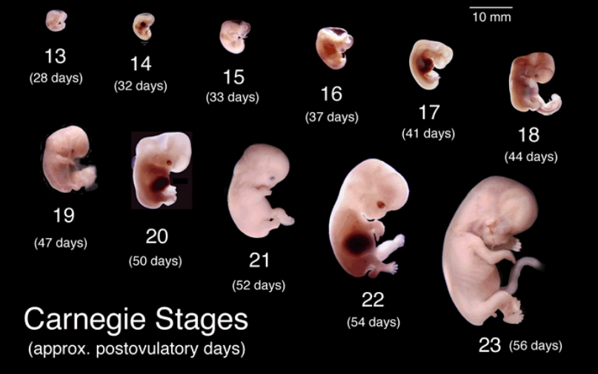

Slide 22
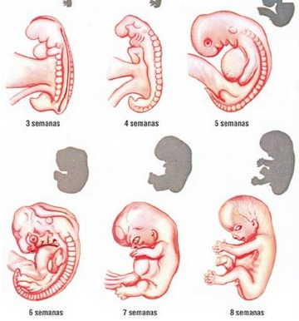
DESARROLLO DEL EMBRIÓN

Slide 23
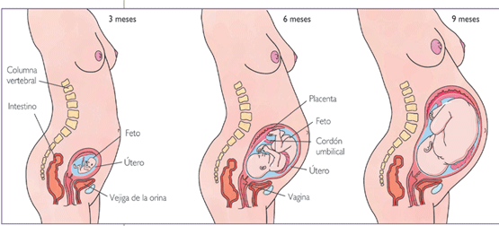
DESARROLLO DEL EMBARAZO

Slide 24
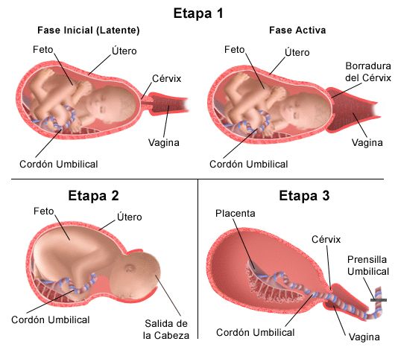
FASES DEL PARTO

Slide 25
COMPLICACIONES DEL PARTO
Mala postura del feto:
Cabeza no encajada en la pelvis de la madre: alarga la fase de expulsión
Posición pedálica: el feto no se ha girado. Hay que practicar cesárea.
Insuficiente dilatación del cuello del útero o de la vagina: se suministra oxitocina que produce dilatación y contracciones.
Pinzamiento del cordón umbilical: provoca falta de riego sanguíneo al feto (no le llega oxígenos). Si se prolonga más de 5 min puede causar daños cerebrales

Slide 26
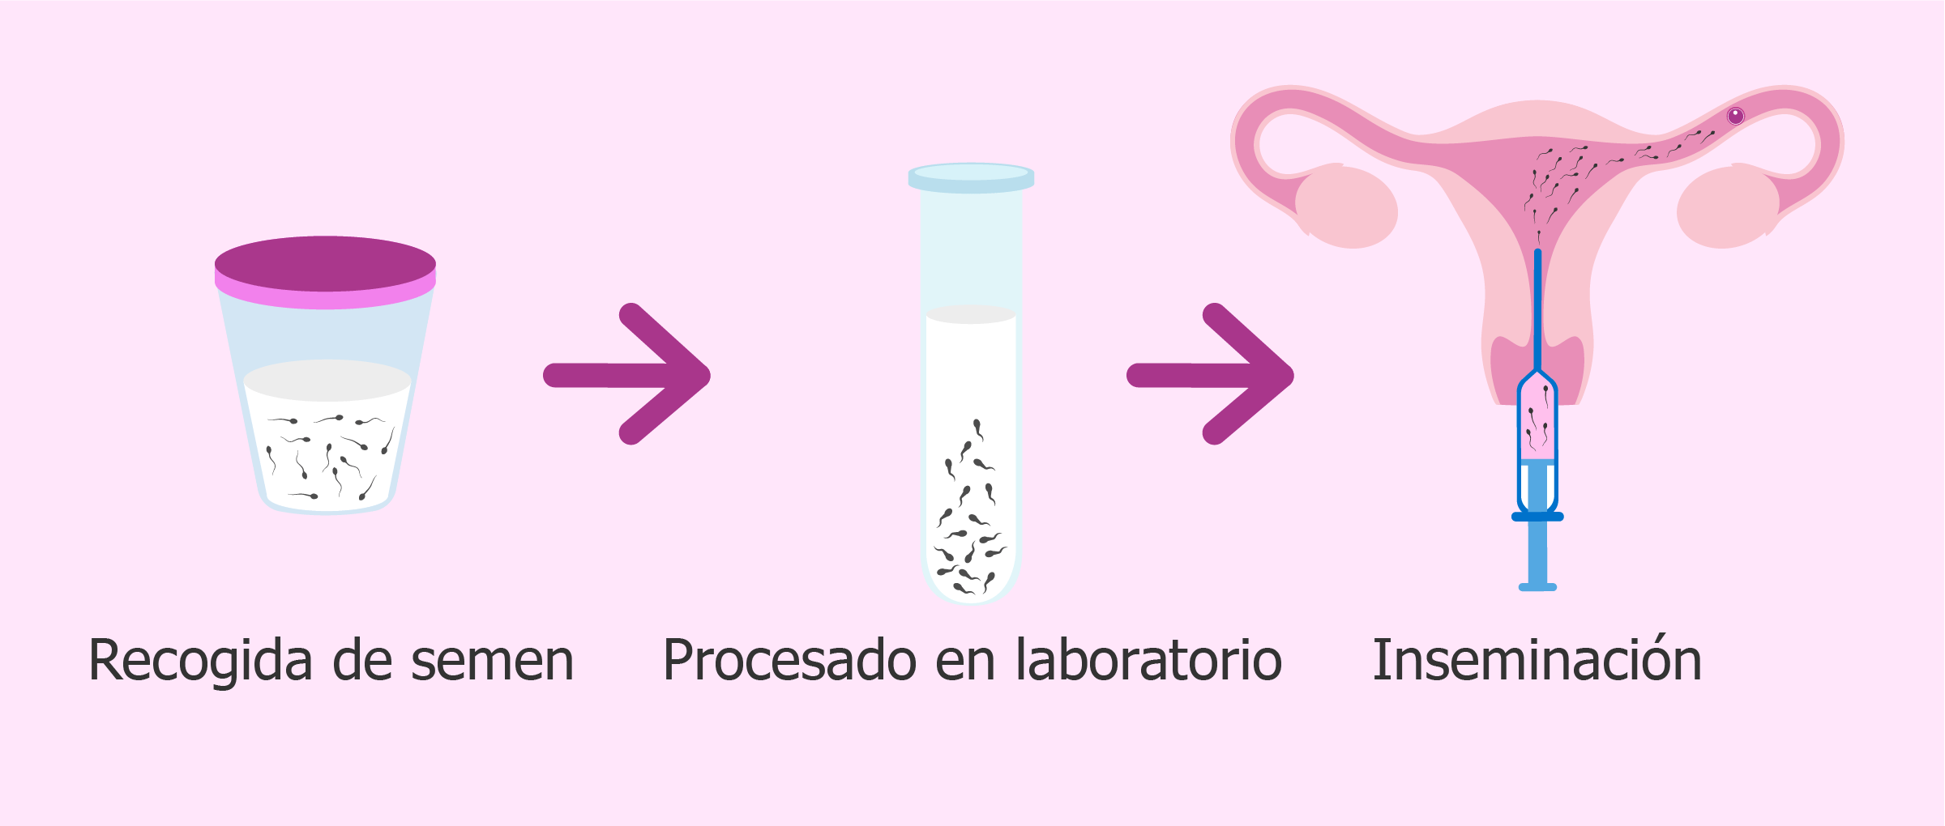
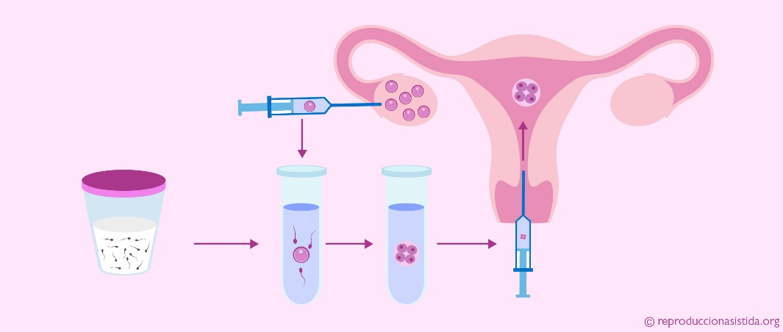
LA ESTERILIDAD
Es la imposibilidad de tener hijos. Se puede dar en el hombre y/o en la mujer. Es necesario realizar una serie de pruebas diagnósticas que permitan determinar las causas de la infertilidad.
TÉCNICAS DE REPRODUCCIÓN ASISTIDA
Inseminación artificial
Fecundación in vitro

Slide 27
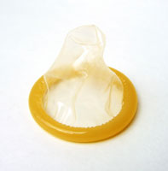
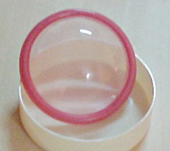
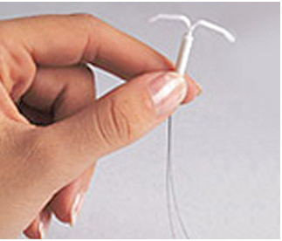
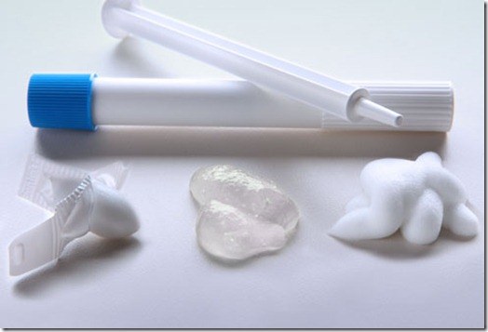
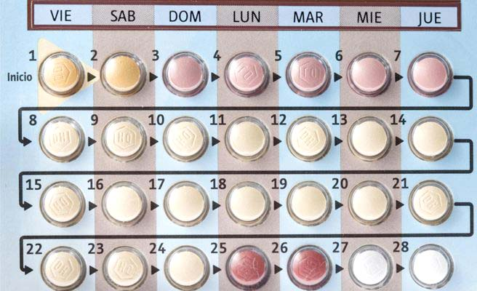
MÉTODOS ANTICONCEPTIVOS
Naturales: ogino, temperatura basal, mucosidad en el cuello uterino
Mecánicos: preservativo, diafragma, diu
Químicos: espermicidas, anticonceptivos orales

Slide 28
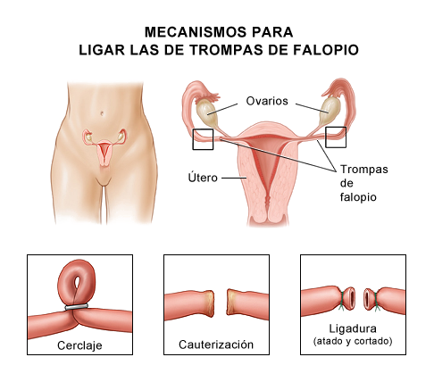
MÉTODOS ANTICONCEPTIVOS
Quirúrgicos: ligadura de trompas y vasectomía

