Slide 1
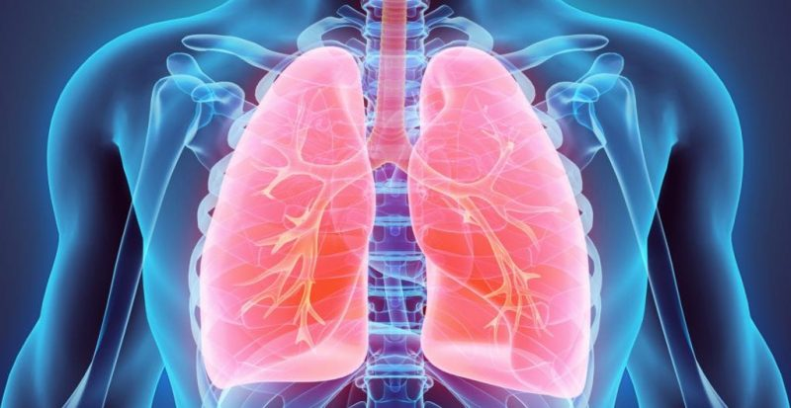
RESPIRATORY SYSTEM

Slide 2
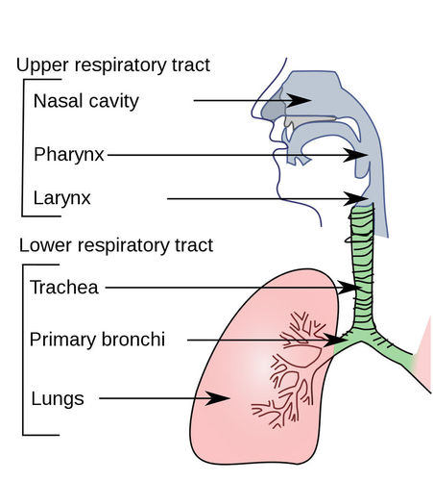
RESPIRATORY SYSTEM ORGANS

Slide 3
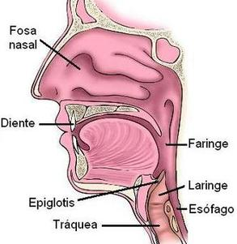
UPPER RESPIRATORY TRACT
Tubular structure that connects the oral cavity and the nasal cavity with the larynx and the oesophagus.
Nasal cavity
Tubular organ that communicate the pharynx with the larynx.
It contains the vocal cords
Oral cavity
Pharynx
Larynx
Epiglottis
Oesophagus
It is a cartilaginous valve that diverts passage to either the trachea or the esophagus
It stands open during breathing, and closed during swallowing preventing the passage of food an liquids to the trachea.
Trachea

Slide 4
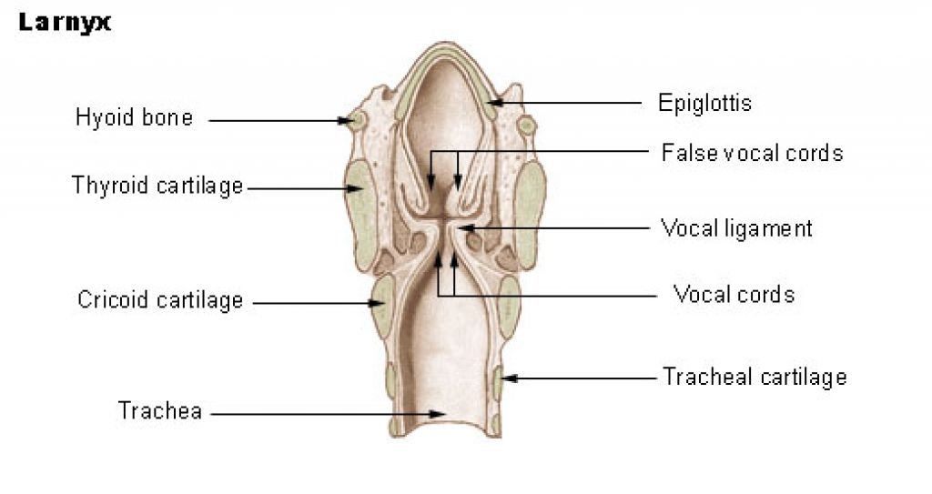
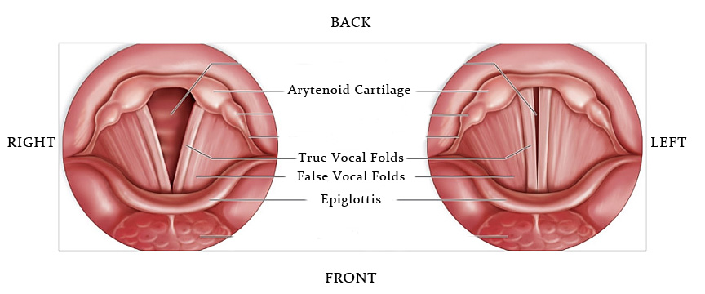

Slide 5
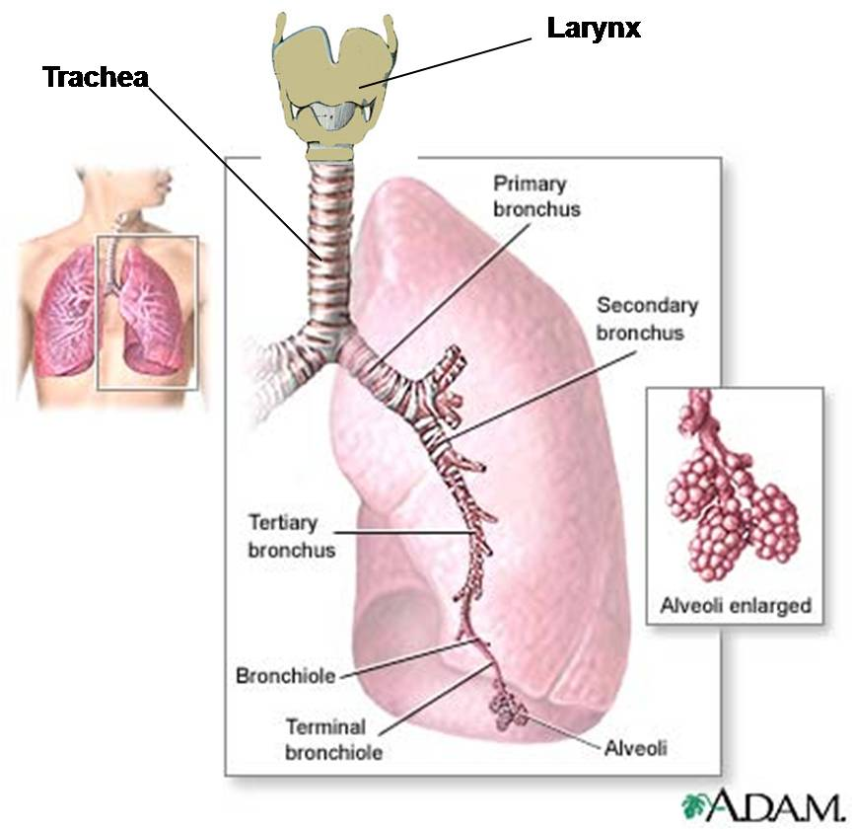
LOWER RESPIRATORY TRACT

Slide 6
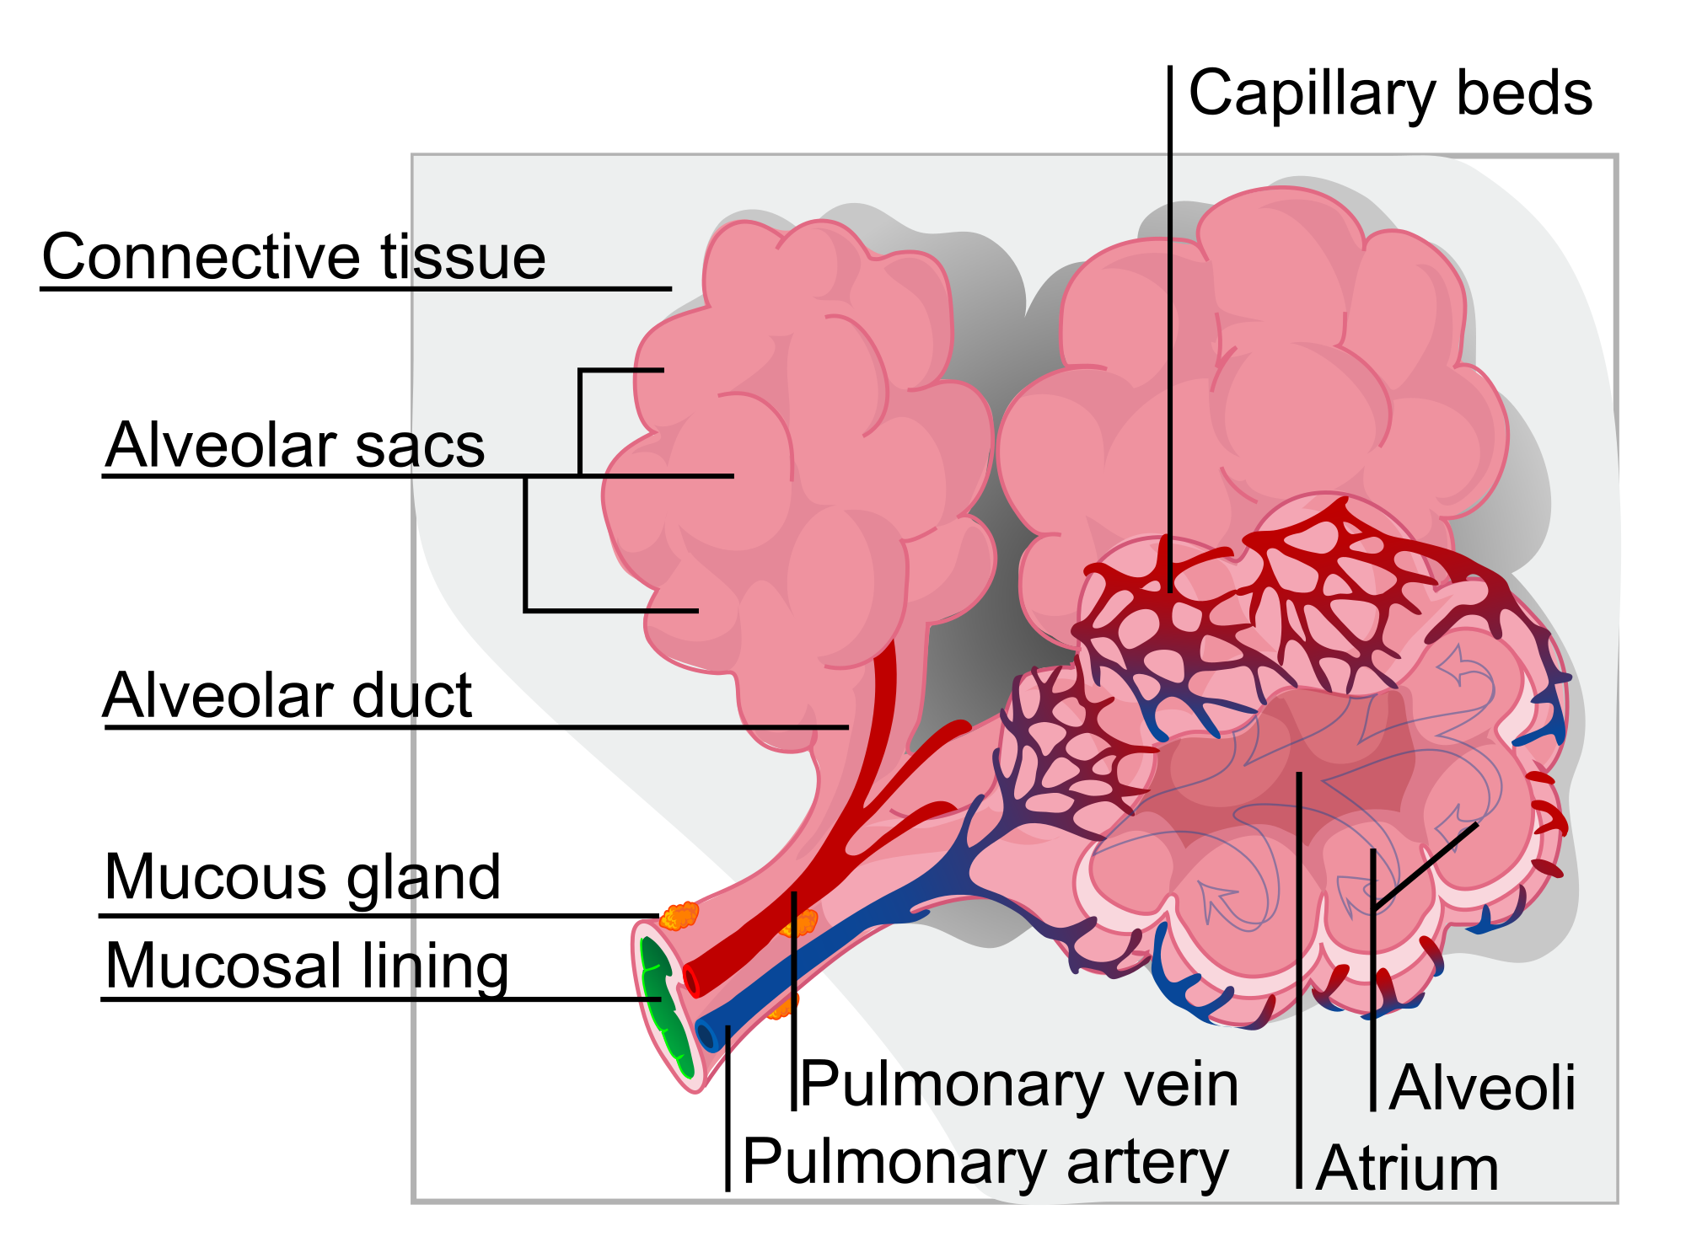
Pulmonary alveolus

Slide 7
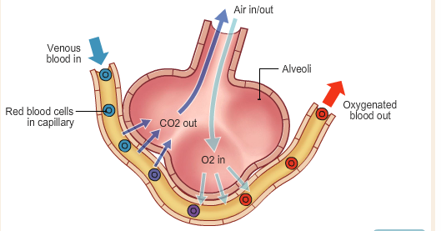
GAS EXCHANGE IN LUNGS

Slide 8
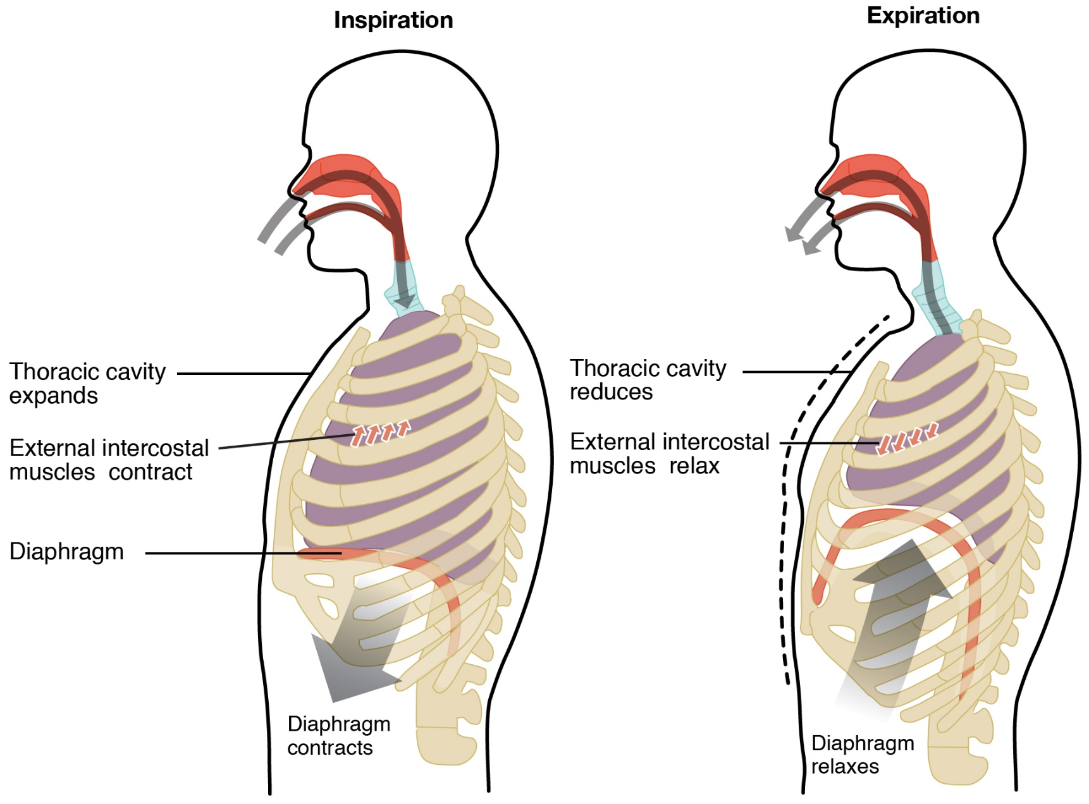
PULMONARY VENTILATION

