Slide 1
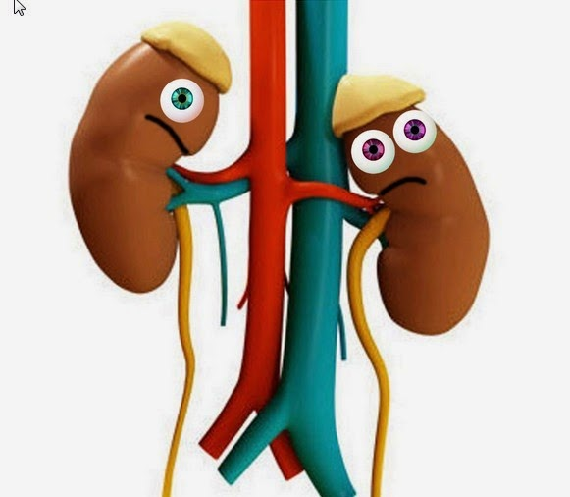
EXCRETORY SYSTEM

Slide 2
EXCRETION
The function of the excretory system is the elimination of waste products.
EXCRETORY SYSTEM
Urinary system: kidneys and urinary tracts.
Sweat glands
Lungs.
Liver.

Slide 3
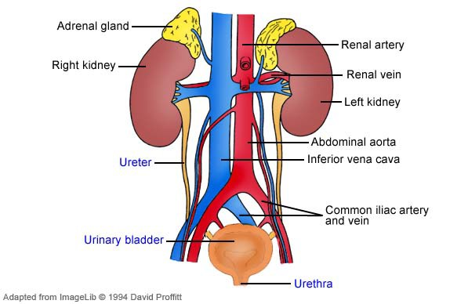
Urinary System

Slide 5
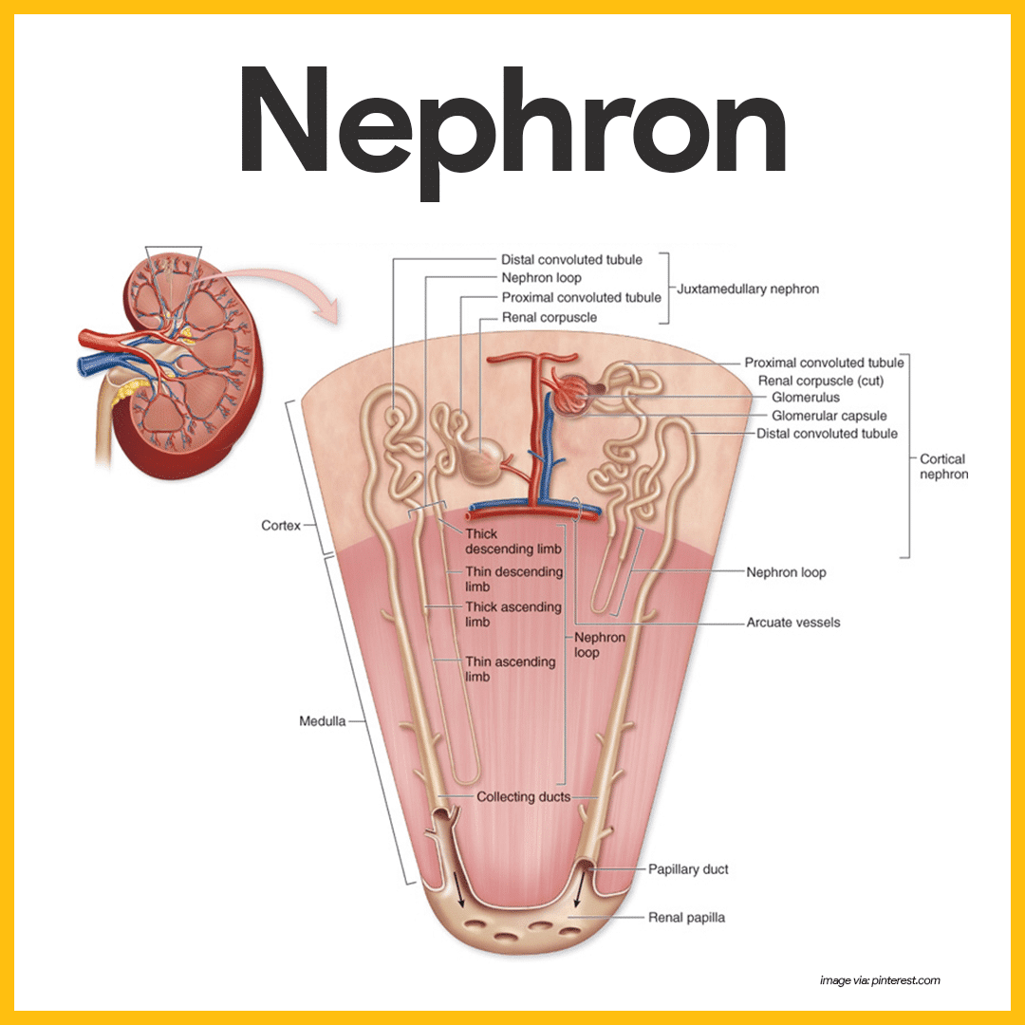

Slide 7
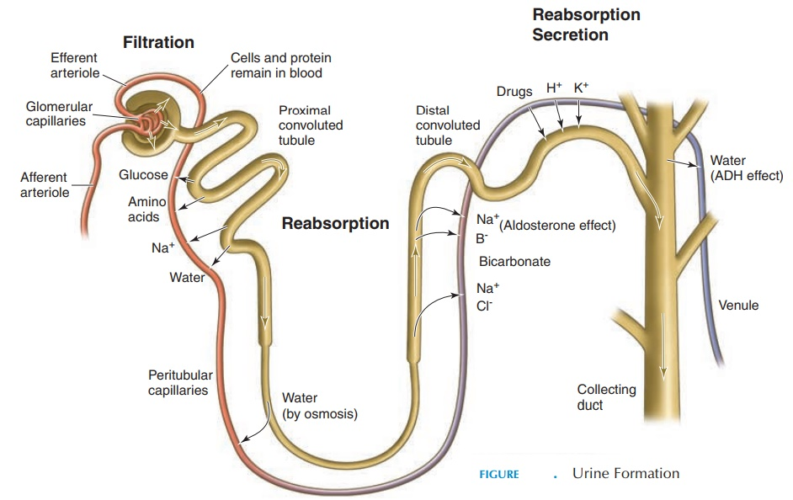
Urine Formation

Slide 8
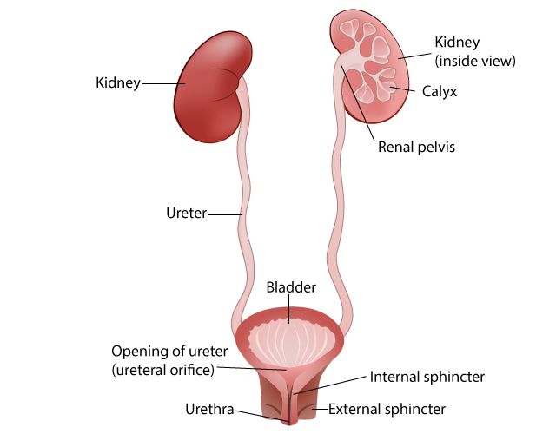
Urinary tracts

